Slide 1
KOLHAN UNIVERSITY, CHAIBASA
CENTRAL LIBRARY
HEARTILY WEL COMES
The
NAAC PEER TEAM

Slide 2
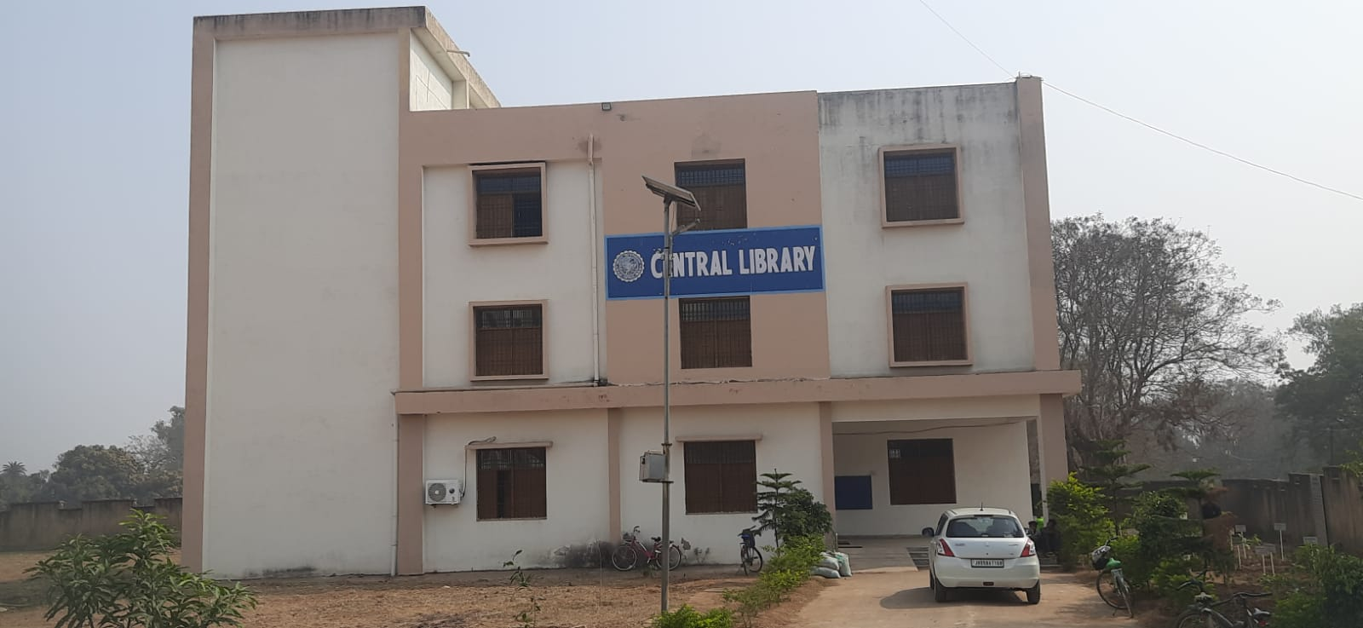
OVERVIEW OF CENTRAL LIBRARY

Slide 3
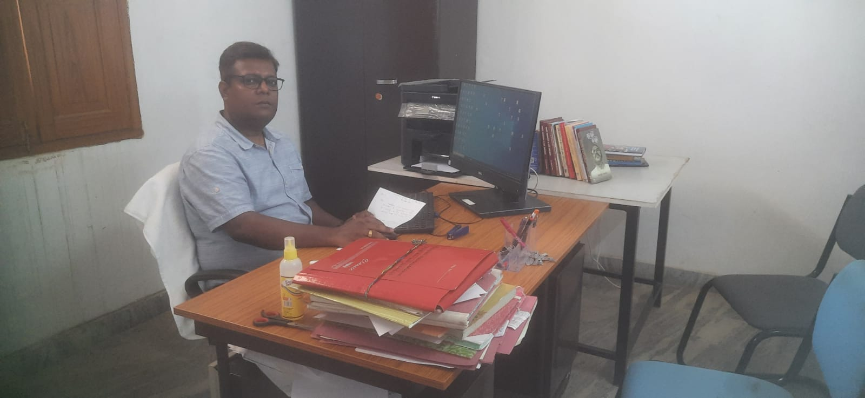
Librarian

Slide 4
Library Staff
Sr. No. | Name of Staff | Designation | Qualification
1 | Mr. Kumar Neel Kanta | Inc. Librarian | M.Sc,BLIS,MLIS,PGDCA
2 | Mr. S S Gautam | Asst.Librarian(Retd.) | M.A. BLIB
3 | Md. Tanveer | Jr. Clerk | M.A.
4 | Mr. Kishore Purty | Jr. Clerk | M.A.
5 | Mrs. Jonga | Peon | S.S.C
5 | Miss Kalpana | Peon | S.S.C

Slide 5
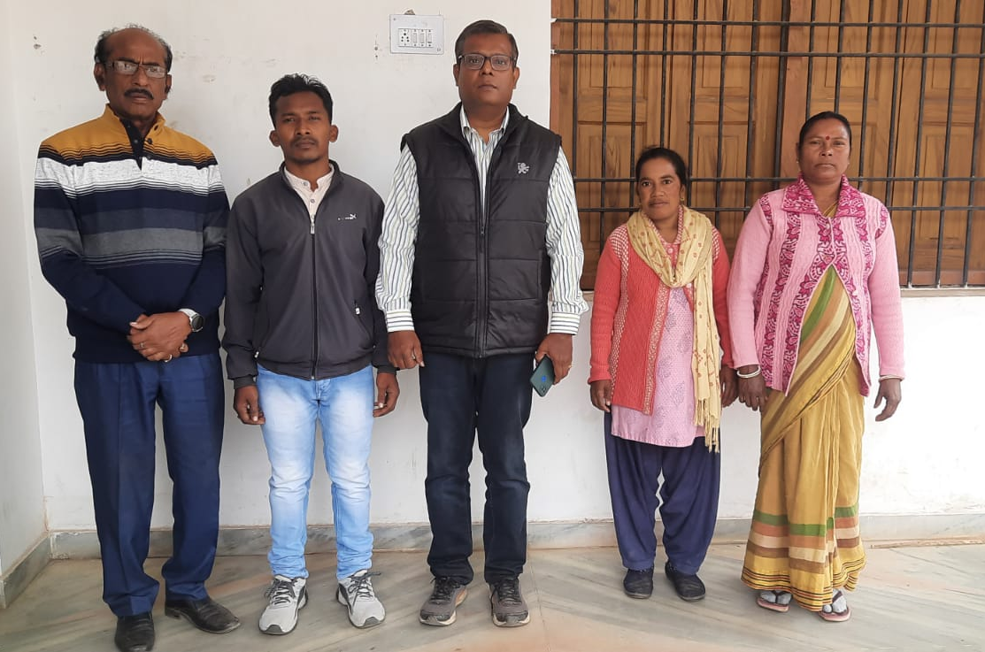
Library Staff

Slide 6
INTRODUCTION
The central library, Kolhan university is fully automated with SOUL 2.0 library management software designed and developed by the INFLIBNET. We provides book, journals , E- Journals , E– Books& internet facility to the teaching staff & students. The library came into existence since the inception of the Kolhan University. The Central Library is spread over 4443sq.Ft. in three floors.

Slide 7
INTRODUCTION
The library is divided in different sections viz. Reference Book Section, Stack Room, Digital Library with internet, Journal and Back Volume section, Reading hall, INFLIBNET Corner, Digital Access section, Faculties Reading Room and Librarian cabin.The library has 12538 books, 78 National & International journals & 75 back volumes journal.

Slide 8
INTRODUCTION
The library also provides Location of Information, Indexing, Current Awareness services, Selective Dissemination Information, Photo copy & Print copy services, for the staff & students. The library aims to be fully integrated with our college libraries in due course of time. We try and provide the best of the services to our ability for proper and smooth functioning of the university.

Slide 9
Library Achivements
Fully Automated with SOUL 2.0 Library Management Software.
MOU with INFLIBNET.
We are the part of the Shodhganga Reservoir, awarded thesis being uploaded on Shodhganga.
We are the registered member of e-Shodhsindhu Consortia.
We are registered in Shodh Shuddhi & using OURIGINAL software for Plagiarism detection.

Slide 10
Library Achivements
Inculcate student interest in reading.
To provide a student friendly atmosphere.
To obtain best & latest reference for students & staff
To upgrade and develop a digital library.

Slide 11
LIBRARY LEARNING RESOURCES
Library no of Books- 12538
Reference Books- 1367
No. of Journals- 78
National- 23
Internationals- 55
E- Journals – 178
Binding Volume- 1231

Slide 12
List of Equipments
Sr.NO | Name of Item | Qty
1 | Computers | 23
2 | Printer (Hp deskjet 1280) | 6
3 | Printer (Bar Code) | 2
4 | Bar code Reader | 1
6 | UPS | 23
7 | Inverter + Battery | 1

Slide 13
LIBRARY SERVICES & FACILITIES
Access of e-Journals + e-Books

Slide 14
LIBRARY SERVICES & FACIILITIES
7 . Plagiarism Dtetection.
. SHODHGANGA – INFLIBNET
. E – Shodh Sindhu Consortium.
. WEB – OPAC
. Sanitary Napkin Vending Machine. (Installed in Girls Toilet)
. Wheelchair service.

Slide 15
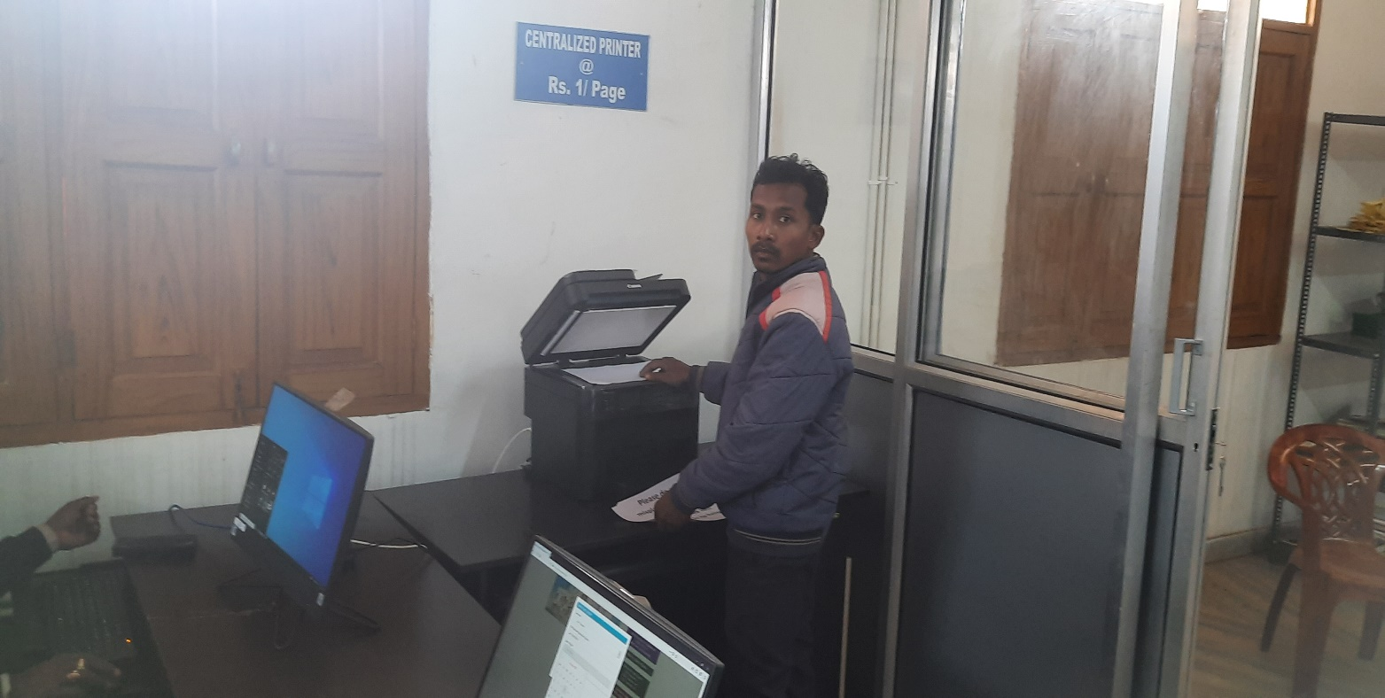
reprography Section
 Central library serves the faculties & students by providing centralized Printout of required literature.

Slide 16
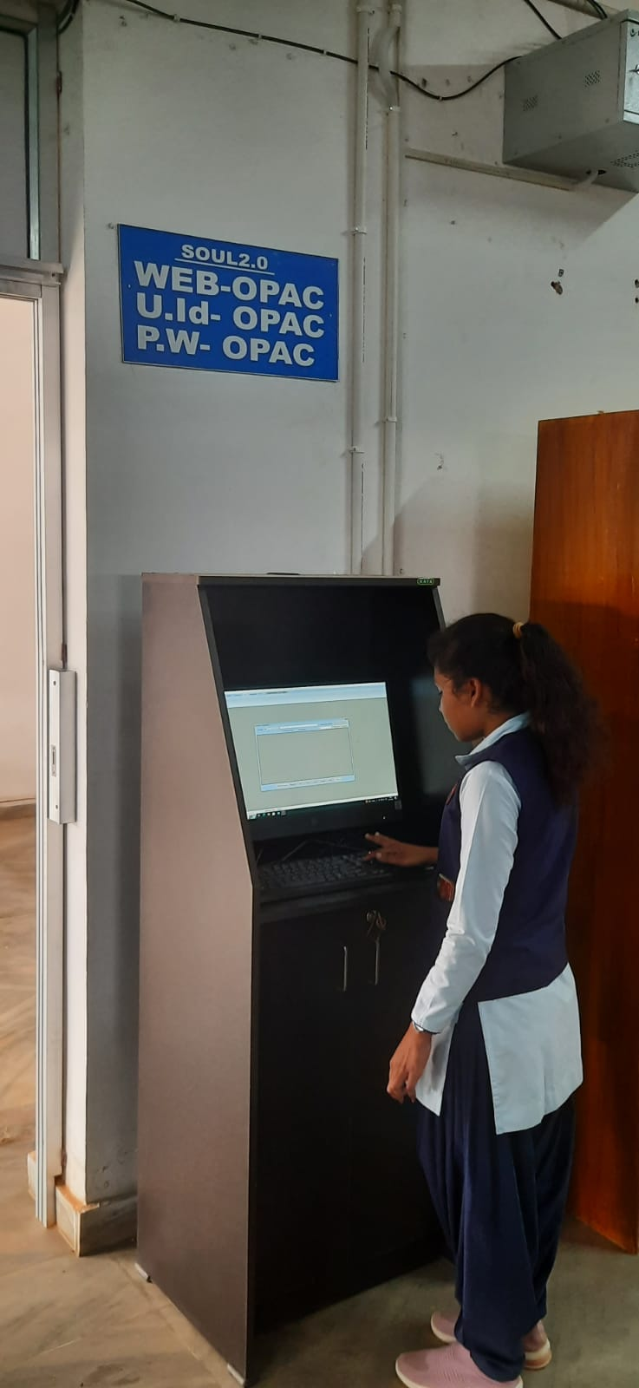
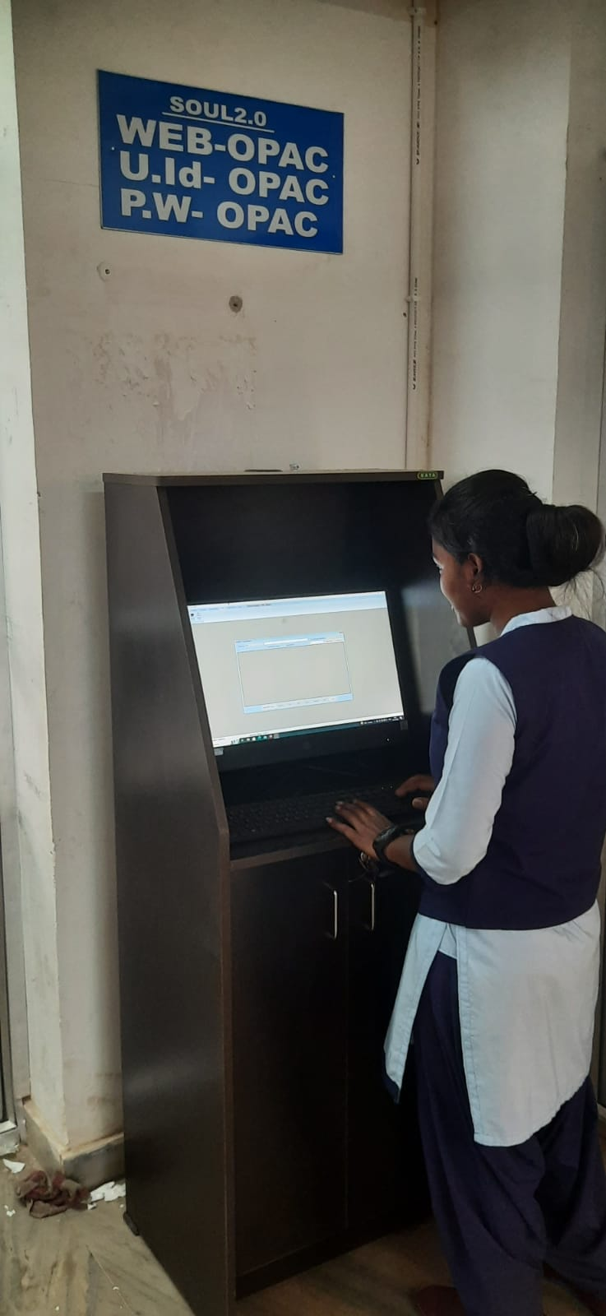
OPAC Section
 Faculty members & students search for online data.

Slide 17
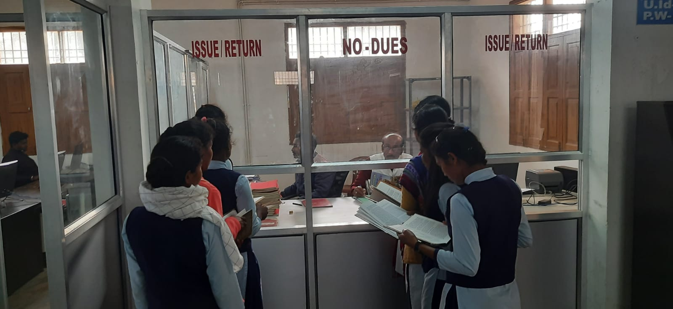
Book Issue/Return counter

Slide 18
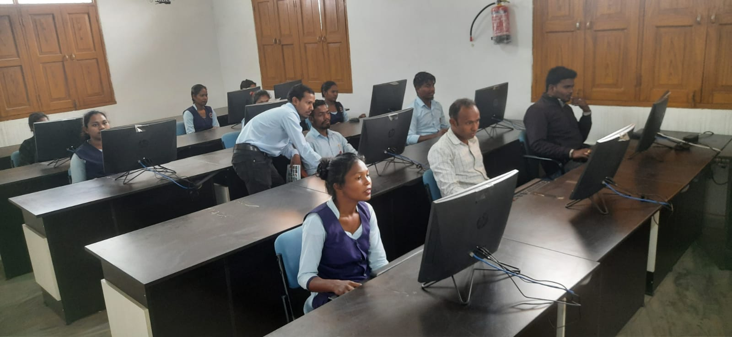
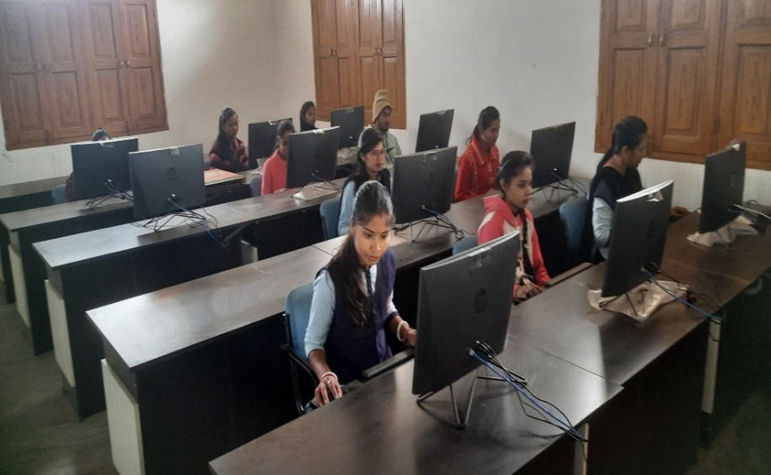
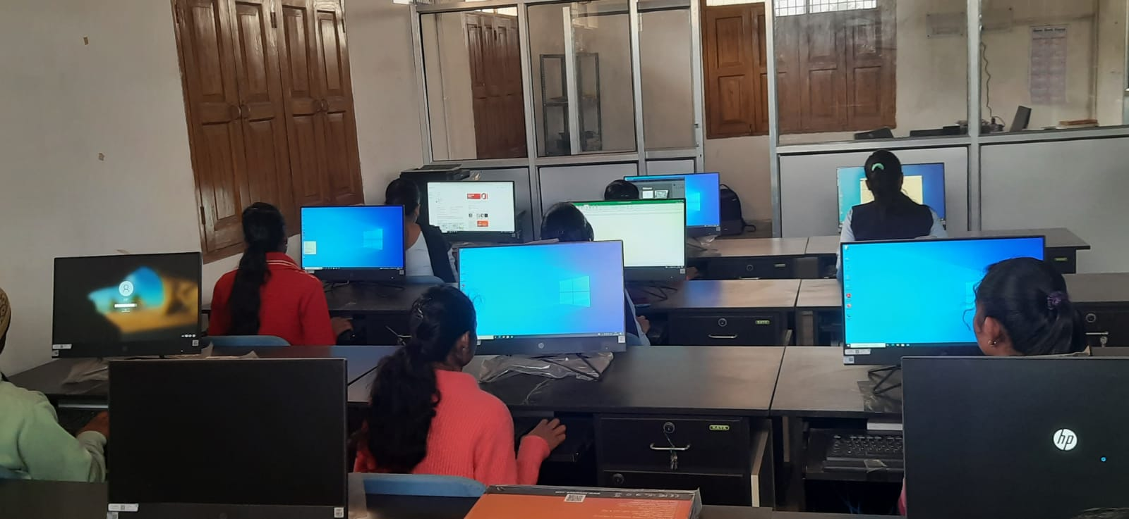
e-Library
Link : https://ndl.iitkgp.ac.in.
https://archive.org.
https://www.doabooks.org
https://www.freetechbooks.com
https://www.indianjournals.com
https://rekhta.org (Urdu Books)
https://www.bangbidya.org
http://www.nsdl.niscair.res.in/jspui
https://www.kolhanuniversity.ac.in/index.php/e-content/courses/ug.html

Slide 19
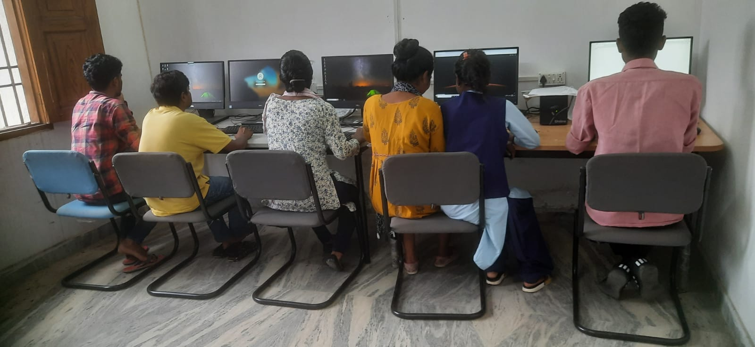
INFLIBNET CORNER

Slide 20
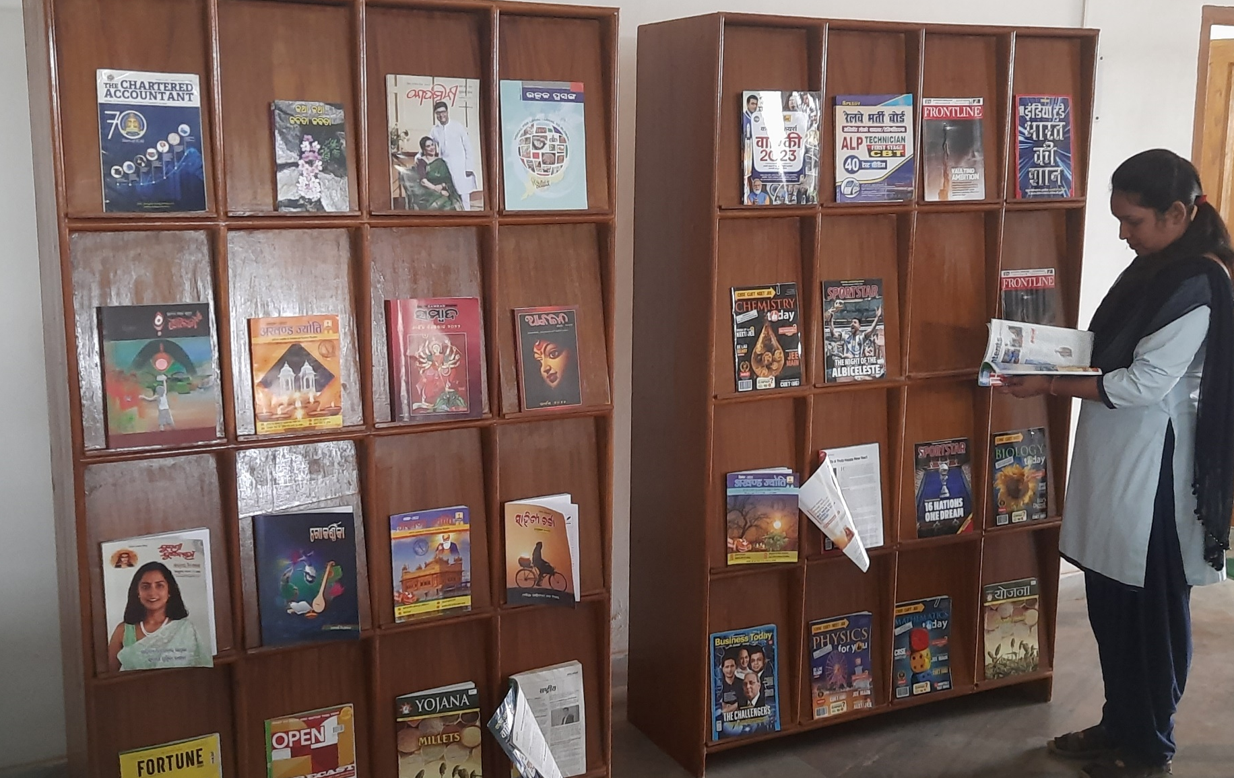
Journal Display Section
 The central library subscribes to 23 national journal & 55 international current journal.

Slide 21
Central Library Books & Title List
Sr. No | Name of Subject | Total title | Total copies
1 | Research Methodology | 110 | 473
2 | TRL | 212 | 507
3 | General Books | 61 | 205
4 | Philosophy | 187 | 475
5 | Psychology | 195 | 453
6 | Sociology | 220 | 535
7 | Anthropology | 230 | 450
8 | Political Science | 233 | 494
9 | Economics | 220 | 341
10 | Education | 236 | 346
11 | Commerce | 320 | 475
12 | Mathematics | 364 | 544
13 | Statistic | 270 | 540

Slide 22
Central Library Books & Title List
Sr. No | Name of Subject | Total title | Total copies
14 | Physics | 305 | 510
15 | Chemistry | 285 | 472
16 | Geology | 291 | 640
17 | Botany | 187 | 285
18 | Zoology | 191 | 295
19 | Home Science | 255 | 567
20 | English | 351 | 795
21 | Sanskrit | 138 | 473
22 | Hindi | 304 | 795
23 | Urdu | 228 | 505
24 | History | 341 | 475
25 | Geography | 315 | 453
26 | Odia | 165 | 435

Slide 23
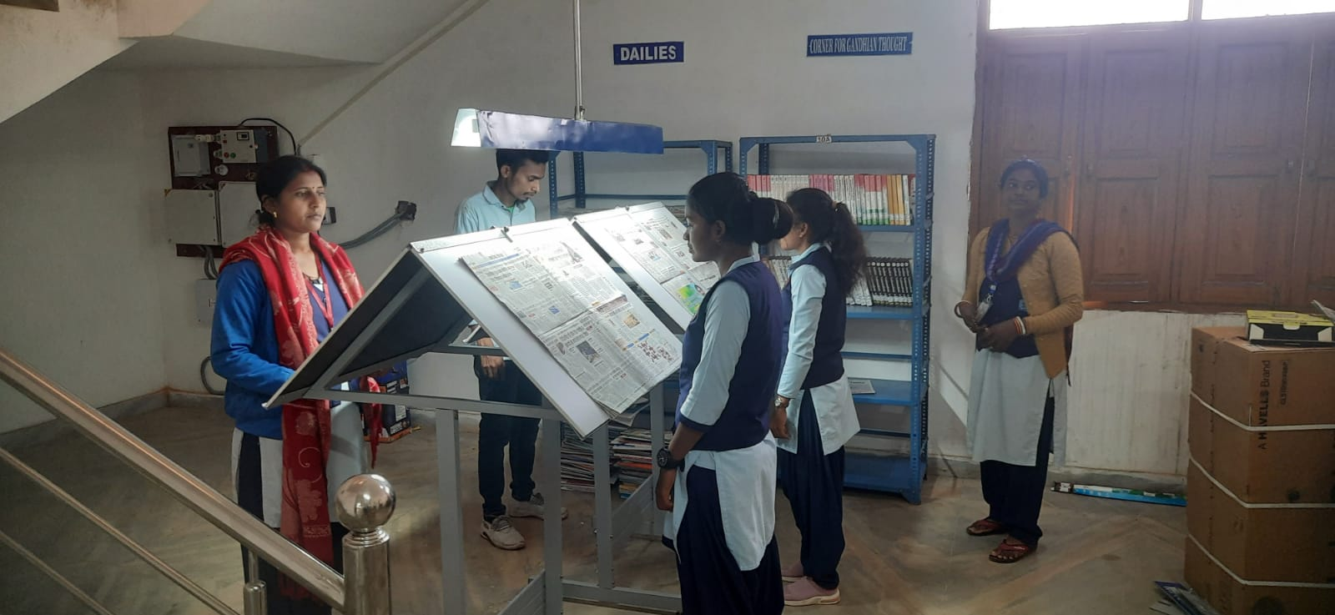
dailies

Slide 24
Book Purchase Information
Sr. No | Year | No. of Copies | Amount
1 | 2016/2017 | 5457 | 4144028=00
2 | 2017/2018 | 4 | 27230=00
3 | 2018/2019 | -- | --
4 | 2019/2020 | 2704 | 3595285=00
5 | 2020/2021 | -- | --=00
 | Total Books = 8165
 | Total Amount 7766543 =00

Slide 25
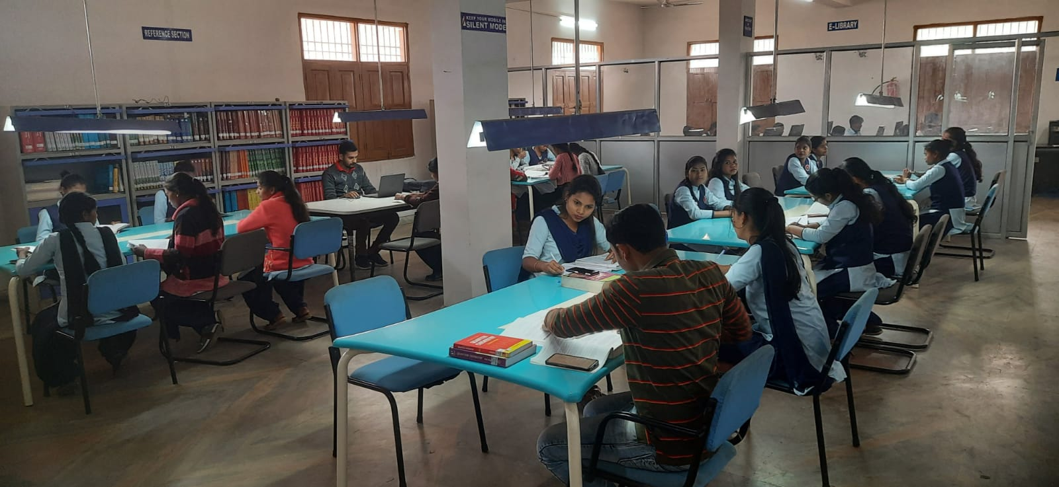
Reading room

Slide 26
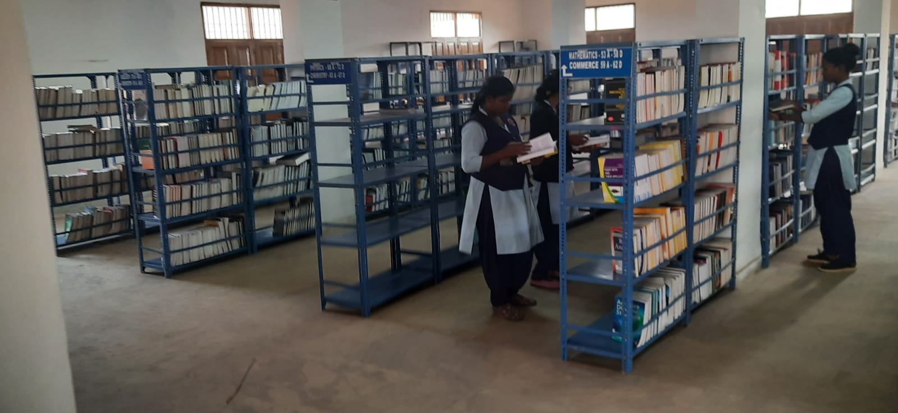
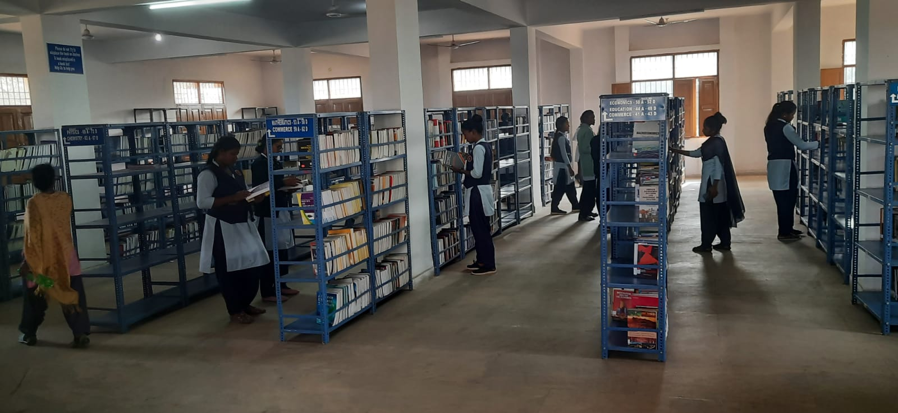
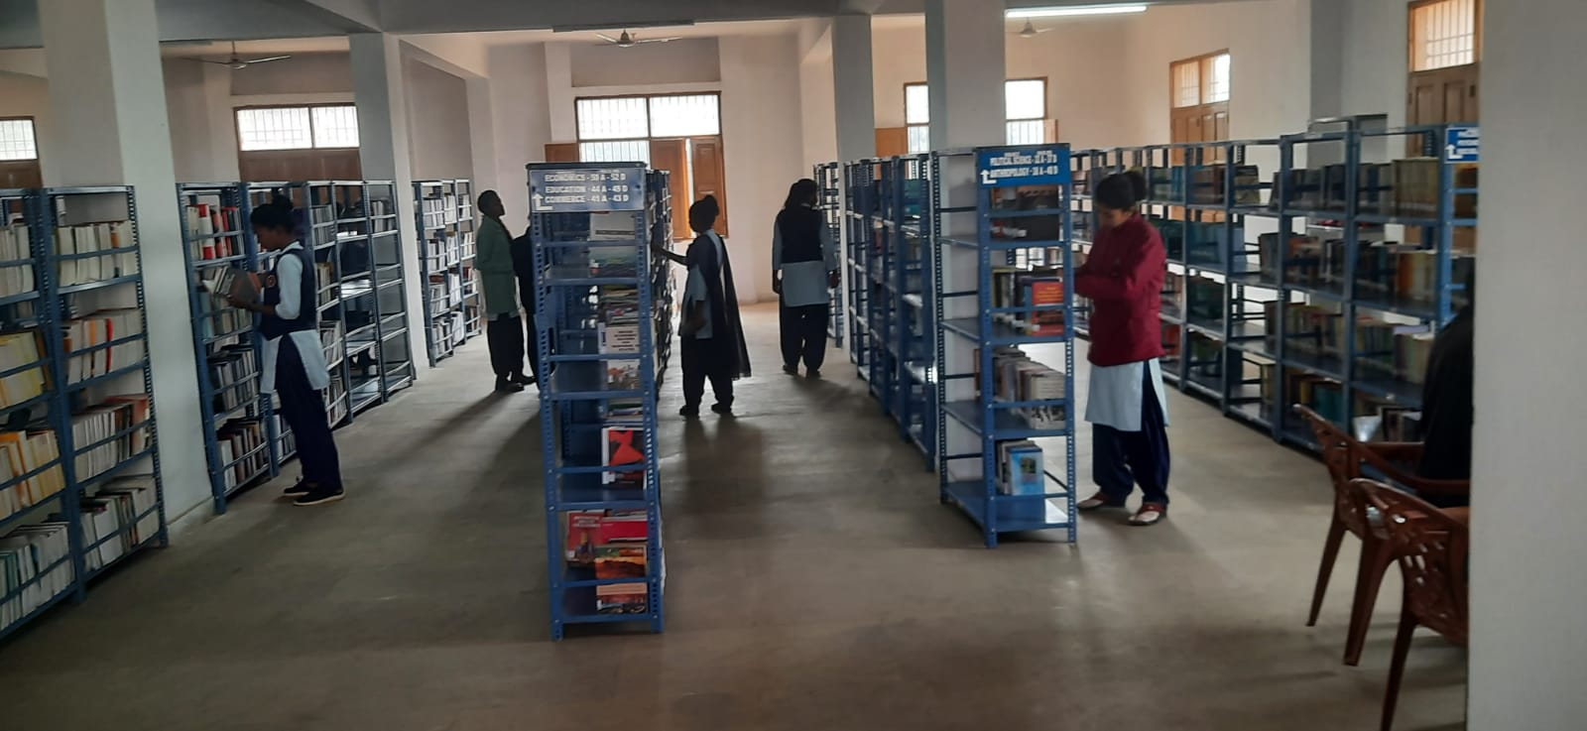
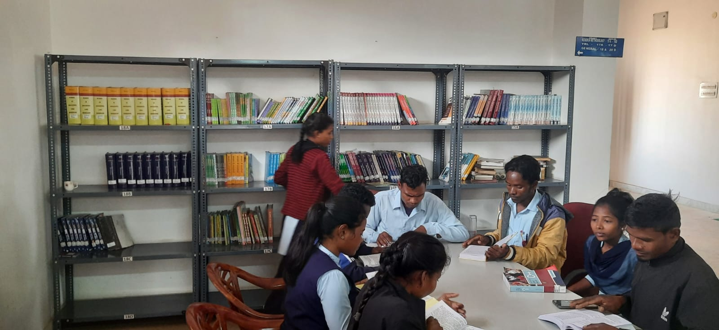
Text-book section

Slide 27
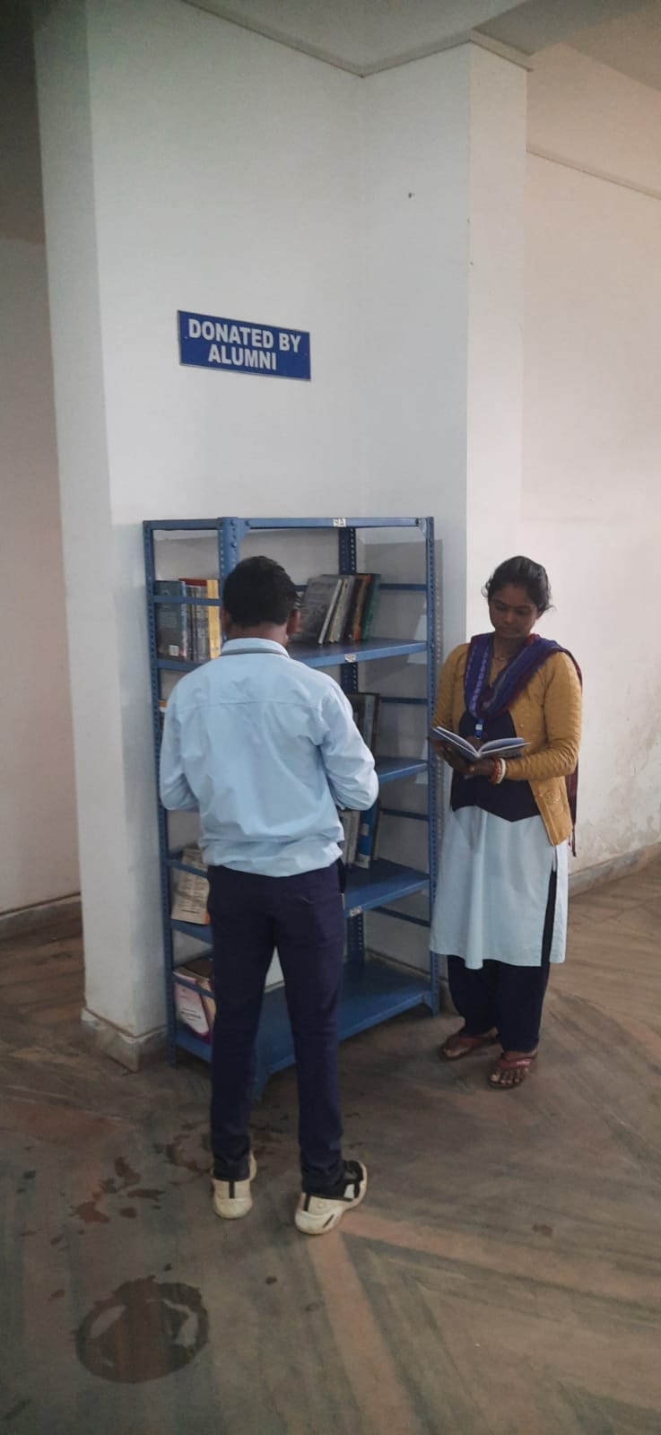
Alumni section

Slide 28
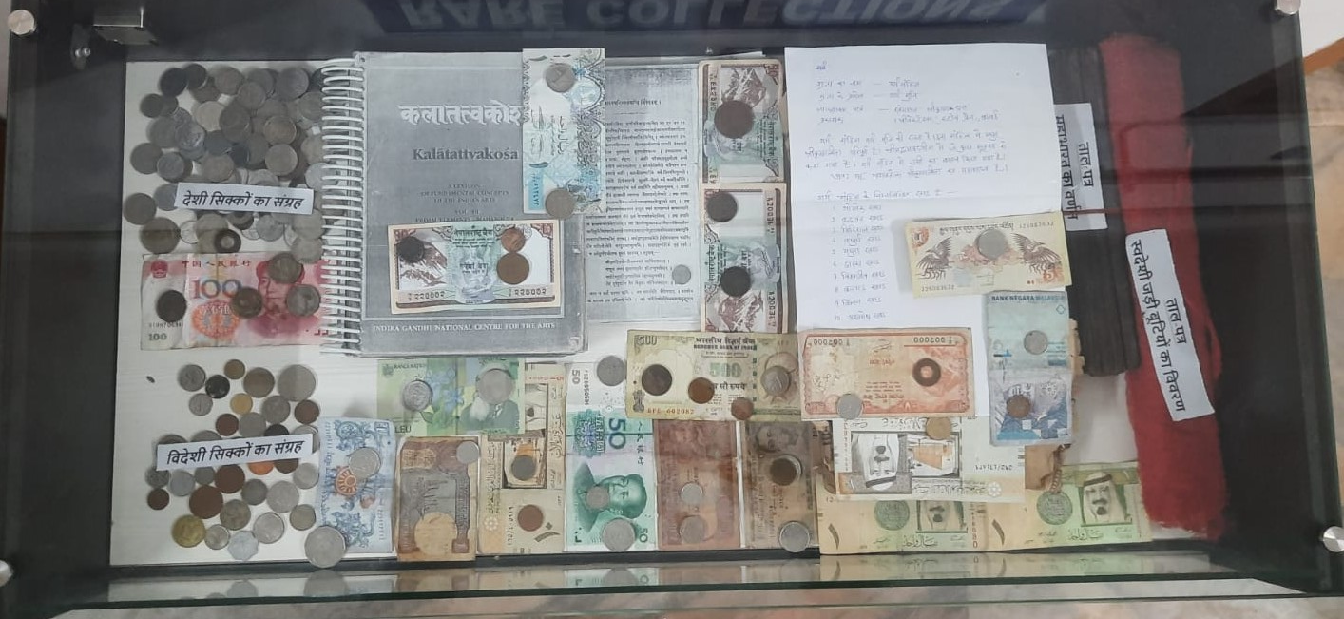
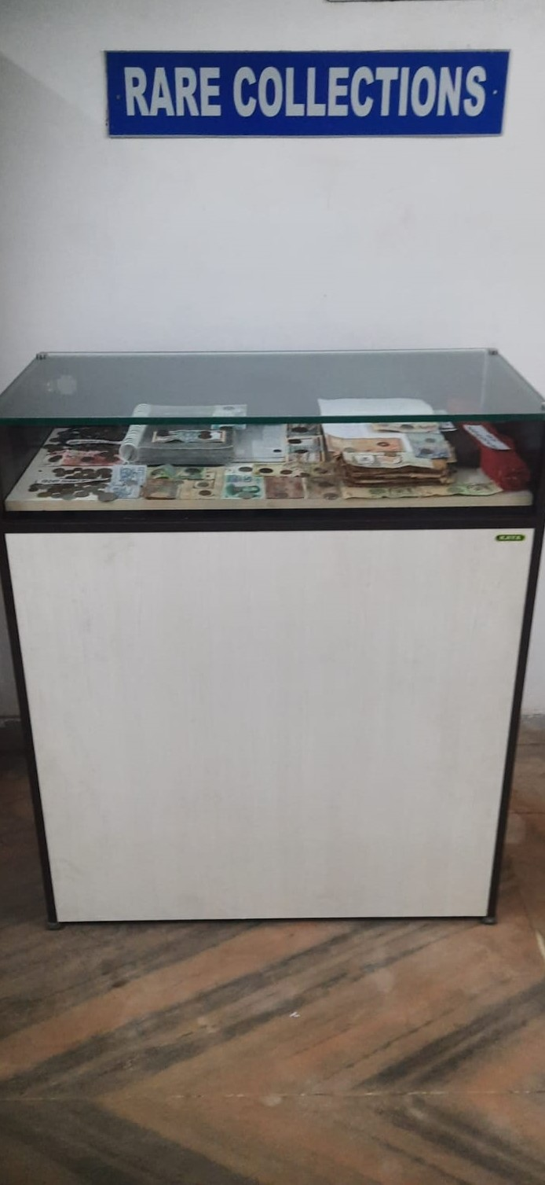
Rare COLLECTIONS (Books+Manuscript+coins+Currency)

Slide 29
FUTURE PLAN OF CENTRAL LIBRARY
►To take efforts to increase students interest in reading and
research.
► To enrich the collection of library.
► To connect all the college libraries under Kolhan University
with the Central Library of the University through networking.
► To procure JAWS Software for Blind users.
► To enrich the digital resources in the Digital information
centre.
► To take membership of more libraries and share their
resources.

Slide 30
Thank you…

